Slide 1

Bankruptcy Prediction for Public Companies
Identifying Key Predictive Features from NYSE and NASDAQ Data
Christian Campbell
Project 1
DSC680

Slide 2

Business Problem
Risks posed by bankruptcies to investors, creditors, and markets
Goal: Improve risk assessment by predicting bankruptcy early
Key Research Questions:
Which financial features best predict bankruptcy?
How early can we predict bankruptcy with high accuracy?

Slide 3
Background and History
"Bankruptcy" derives from Latin words "bancus" (bench) and "ruptus" (broken).
U.S. bankruptcy law evolved from a punitive system to a "fresh start" model.
SEC distinguishes between Chapter 11 (reorganization) and Chapter 7 (liquidation).

Slide 4
Data Source and Preparation
Dataset from Kaggle (Utkarsh Singh)
8,262 companies, 78,682 observations (1999-2018)
Removed company name and year, converted status labels to numerical values

Slide 5
Methods and Model Selection
Data split into features (X) and target (y)
80/20 split for training and testing
LightGBM Classifier used for training
Evaluation metrics: accuracy, confusion matrix, classification report

Slide 6
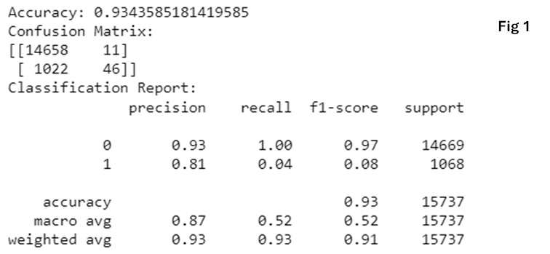
Model Results and Evaluation
Accuracy: 93.44%
Confusion matrix shows model bias toward predicting non-bankrupt companies
High precision for non-bankrupt class (0.93) but low recall for bankrupt class (0.04)

Slide 7
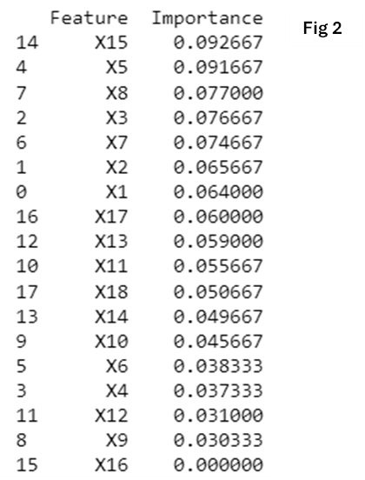
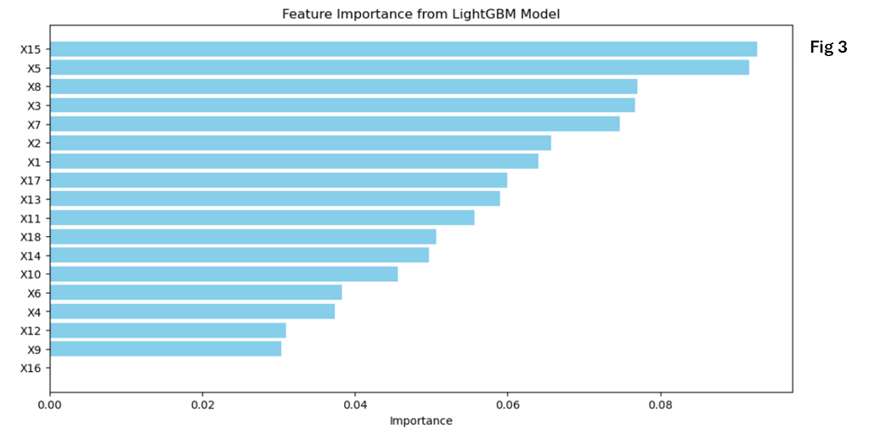
Feature Importance
Retained earnings, inventory, and market value were the most predictive features.
Total revenue had negligible importance.

Slide 8
Limitations and Challenges
Class imbalance: More non-bankrupt companies than bankrupt
Limited to NYSE and NASDAQ, between 1999-2018
Model doesn’t account for qualitative factors like market sentiment or management decisions

Slide 9
Future Uses and Recommendations
Could be adapted for different industries or markets
Financial institutions could integrate the model into risk assessment frameworks
Need to address class bias and improve recall for bankrupt companies

Slide 10
Conclusion
Strong overall accuracy but weak performance in predicting bankrupt companies
Significant predictors identified, but model improvement is needed for practical application
Ethical considerations important for implementation

